Slide 1
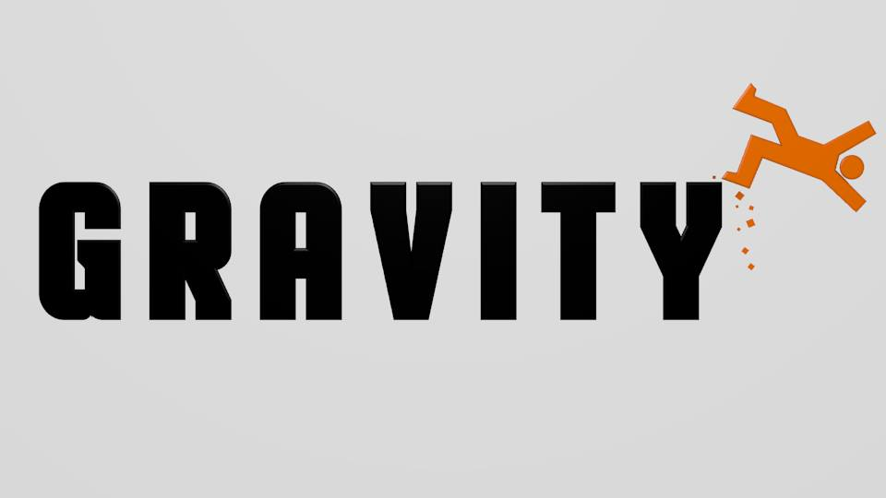
Team Gravity

Slide 2
Intellectual Properties
Found in a Software Application

Slide 3
Types
Foundation of software industry
Intellectual properties found in software:
Patents
Copyrights
Trade Secrets
Trademark

Slide 4
Trademark
Recognizable sign, design or expression
Patents, copyrights and trade secrets can be used to protect technology itself
Trademarks do not protect technology

Slide 5
Patents
Protection of “ideas”
20 year exclusive monopoly
Described in detail
Available to public

Slide 6
Obtaining Patents
Must apply to patent office
Must be demonstrated as new, useful and “nonobvious”
More than trivial, obvious next step in the advance of technology

Slide 7
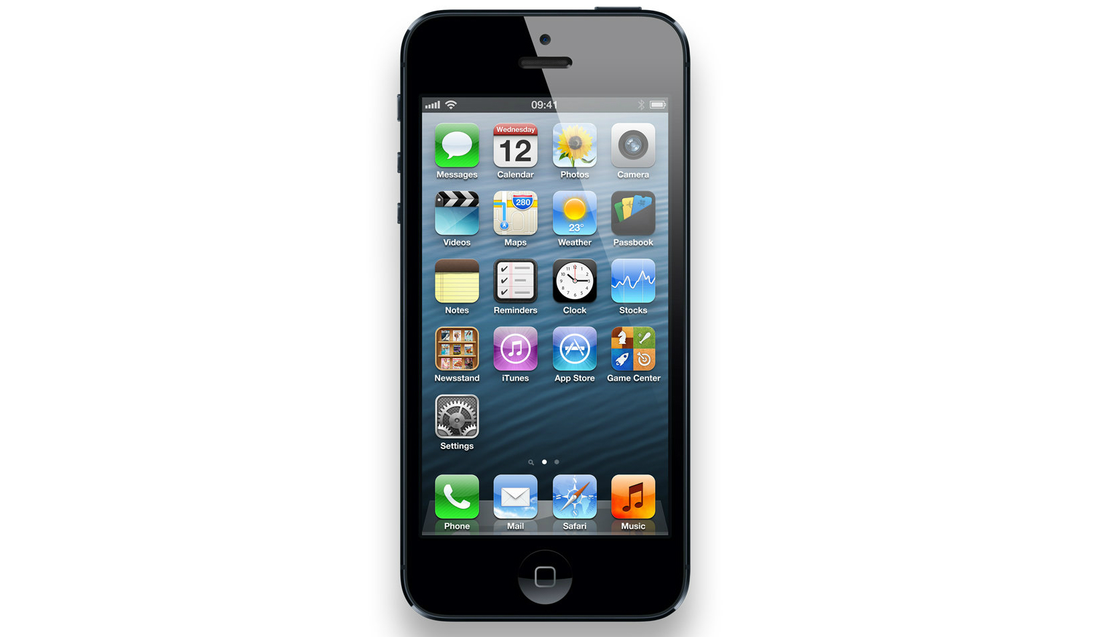

Patent examples
Algorithms, methods, systems
User-Interface Feature, Menu features
Apple patents

Slide 8
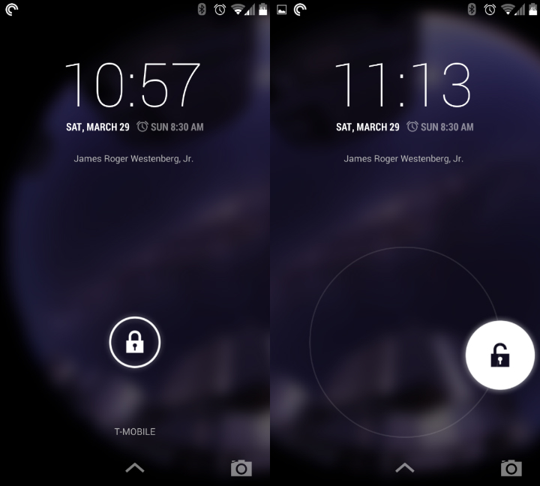
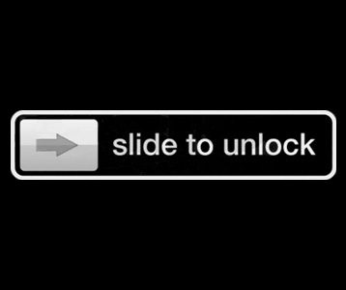
Patent examples

Slide 9
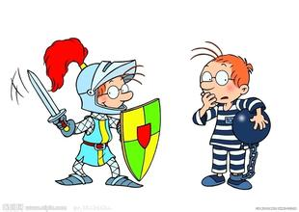
Copyright
What is copyright?
What is software copyright?
1. all the program code itself
2. documents that used to describe the contents,
design, testing results, etc. of a program.

Slide 10
Copyright
The difference between software copyright and patent:
COPYRIGHT | program itself | concrete
PATENT | development idea | abstract
Software copyright has nothing to do with protecting the most valuable thing in a software —— design ideas

Slide 11
Copyright
Features of copyright :
Made upon creation
Applying is unnecessary
Copyright protection is lifelong

Slide 12
Trade Secret
Any formula, pattern, process, tool or mechanism
Theoretically lasts forever
Subject to theft and not “infringement”

Slide 13
Conclusion
Intellectual properties are important!
Take caution with your projects!
Protect your hard work!

Slide 14
Questions?

